Slide 1

NS
LECTURE
Module Overview
Network Security
Diploma in CSF
Year 3 (2021/22), Semester 5
0

Slide 2
Objectives
At the end of this briefing, you will get to know more about:
Teaching Team
Module Synopsis
Module Topics
Assessment
Teaching Mode
Reading List

Slide 3
Teaching Team
Mr. Liew Yoon Hin (ML)
LIEW_Yoon_Hin@np.edu.sg
6460 8256
Mr. Sun Lei
Sun_Lei@np.edu.sg
6460 7573

Slide 4
Module Synopsis
This module provides an in-depth knowledge on network security in a defensive view.
It covers various types of firewall technologies, Virtual Private Networks (VPNs), and Intrusion Detection/Prevention Systems (IDS/IPS).
Students will have a chance to configure and deploy state-of-the-art networking devices in a typical computer network.

Slide 5
Module Synopsis – cont.
Students will be taught skills to identify the internal and external threats against a network and to develop security policies that will protect an organization’s information.
Students will also learn how to implement successful security policies and firewall strategies in this module.
In this module, students are assessed by coursework only.
Notes:
No exams!

Slide 6
Module Topics (Indicative)
Fundamentals of Computer Network Infrastructure
TCP/IP Fundamentals
Network Security Threats and Issues
Firewall Technologies – Different types of firewalls
Firewall Deployment and Configuration
Application filtering
Content filtering
Encryption, Cryptography and Digital Signatures
Virtual Private Networks
Intrusion Detection/Prevention Systems
Network Vulnerability Assessment
Notes:
No exams!

Slide 7
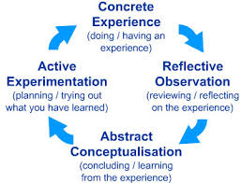
Teaching Mode - Experiential Learning
Every week you will have …
2 hours of Lecture/Tutorial
Obtain knowledge (concepts, facts, and information) through formal learning and past experience;
2 hours of Practical
Practice activities to apply the knowledge to a “real world” setting;

Slide 8
Assessment
Coursework Remarks %
CA Practical-based 40
Assignment Week 5-18 30
Common Test Week 8 30
Total 100
Refer to Teaching Plan for more details.

Slide 9
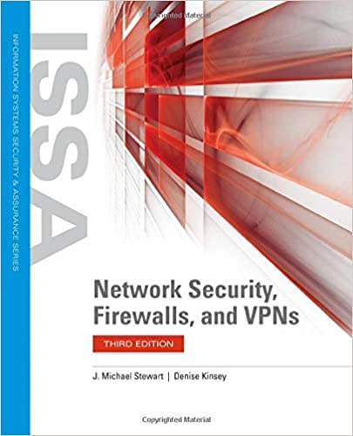
Reading List
Reference book:
Network Security, Firewalls, and VPNs (Issa) 3rd Edition
J. Michael Stewart (Author), Denise Kinsey (Author)

Slide 10
Q & A

